Slide 1





IN1901
Microcontroller Based Application Development Project
GREENCARE ASSIST
(Condition Controlled Ornamental Plant)
Group No : 46
Information Technology
University of Moratuwa
Batch 22

Slide 2







GROUP MEMBERS
224069V
Harishanth K.
224038C
Dhanuja S.A.
224199T
Tishanth S.
224164H
Raveendran A.
224103X
Karunarathna W.D.M.M.S

Slide 3
PROBLEM IN BRIEF
Where do we find this problem?
Manual caring of plants is time-consuming and physically demanding in urban busy lifestyle.
Current challenges?
Urban residents often struggle with maintaining optimal conditions for their plants due to limited time and inconsistent monitoring, leading to plant stress and poor health.
Need for a solution
An automated plant care system can ensure consistent thermal, humidity, and watering control, simplifying plant maintenance and improving plant health for busy urban dwellers.

Slide 4
AIMS AND OBJECTIVES
Aims:
By employing advanced technology and automated functionalities, we aim to bridge the gap between people's desire to surround themselves with the beauty of nature and the challenges imposed by today's demanding lifestyles. We are hoping to close the gap between serine beauty of plants mostly endemic to completely endemic to different eco system and bring the beauty of serine nature to busy human life-style.

Slide 5
AIMS AND OBJECTIVES
Objectives:
1. Temperature Detection
To get a precise data about temperature inside the container
2.Humidity Detection
To get a precise data about Humidity inside the container
3. Temperature Control
To control and maintain temperature of the container to mimic the original Temperature of the original eco-system of the plant

Slide 6
AIMS AND OBJECTIVES Ctd.
4.Humidity Control
To control and maintain Humidity of the container to mimic the original Humidity of the original eco-system of the plant
5. Soil Moisture Detection
To detect the water and wetness level of the medium that plant planted in.
6. Alert System
To let know the host that medium of the plant is lacked in moisture and water levels in three different levels of alert levels.
7.Lighting System
To maintain a lighting system which supports the photosynthesis purposes of plant and as well as the aesthetic visualization.

Slide 7
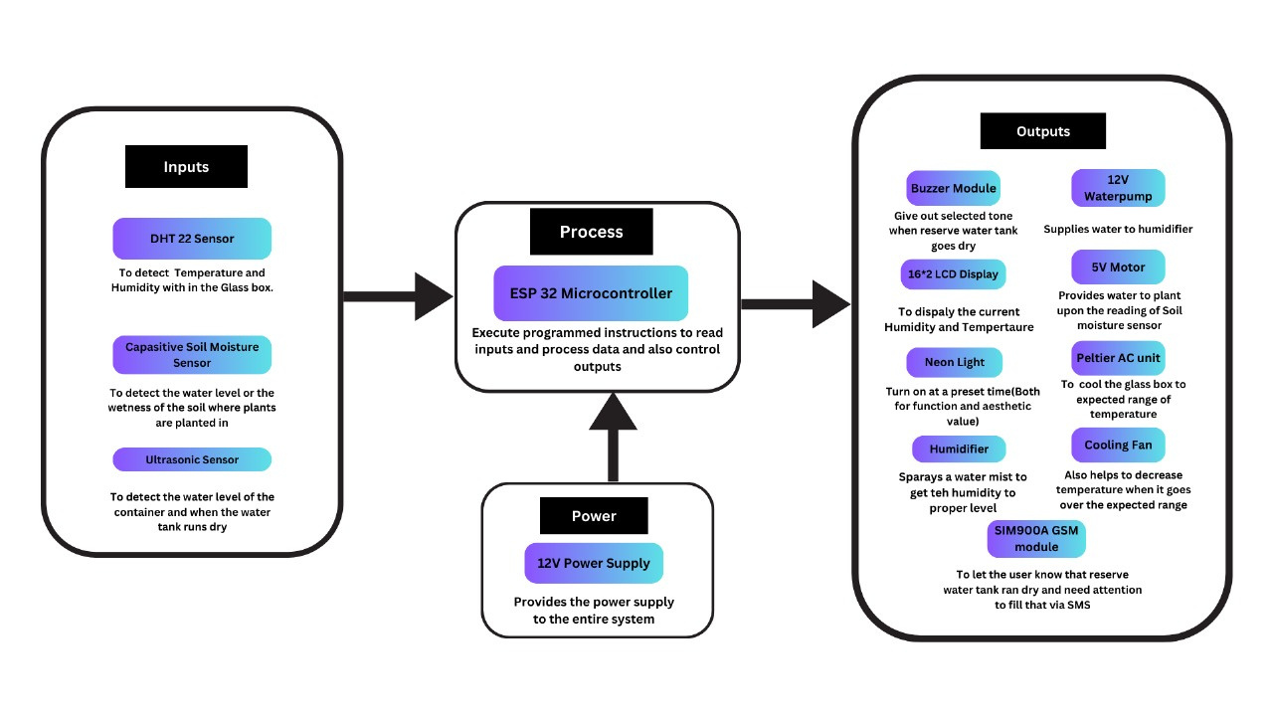
Proposed Solution (System Diagram)

Slide 8
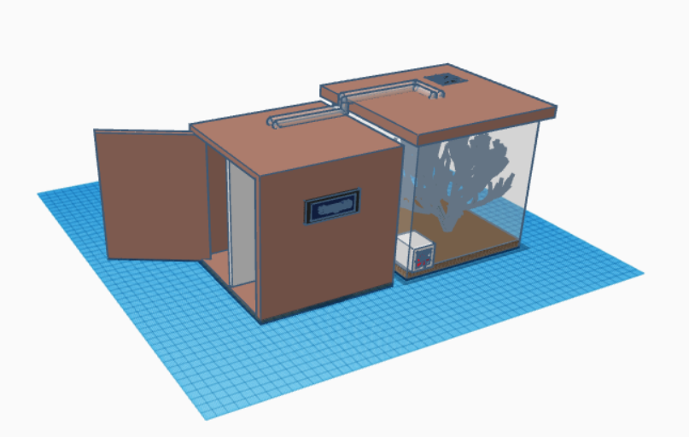
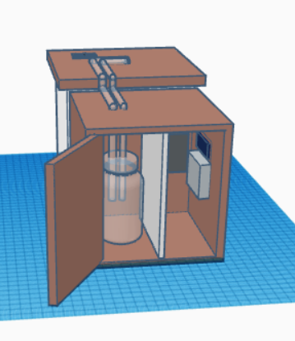
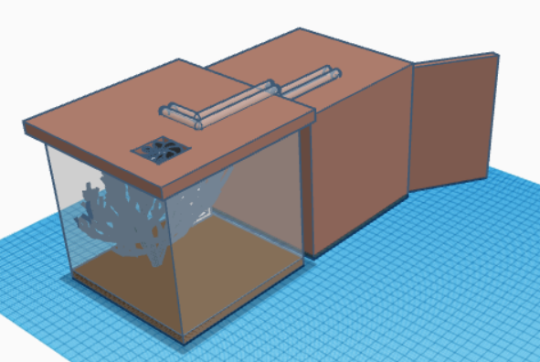
3D DESIGN OF THE SYSTEM

Slide 9
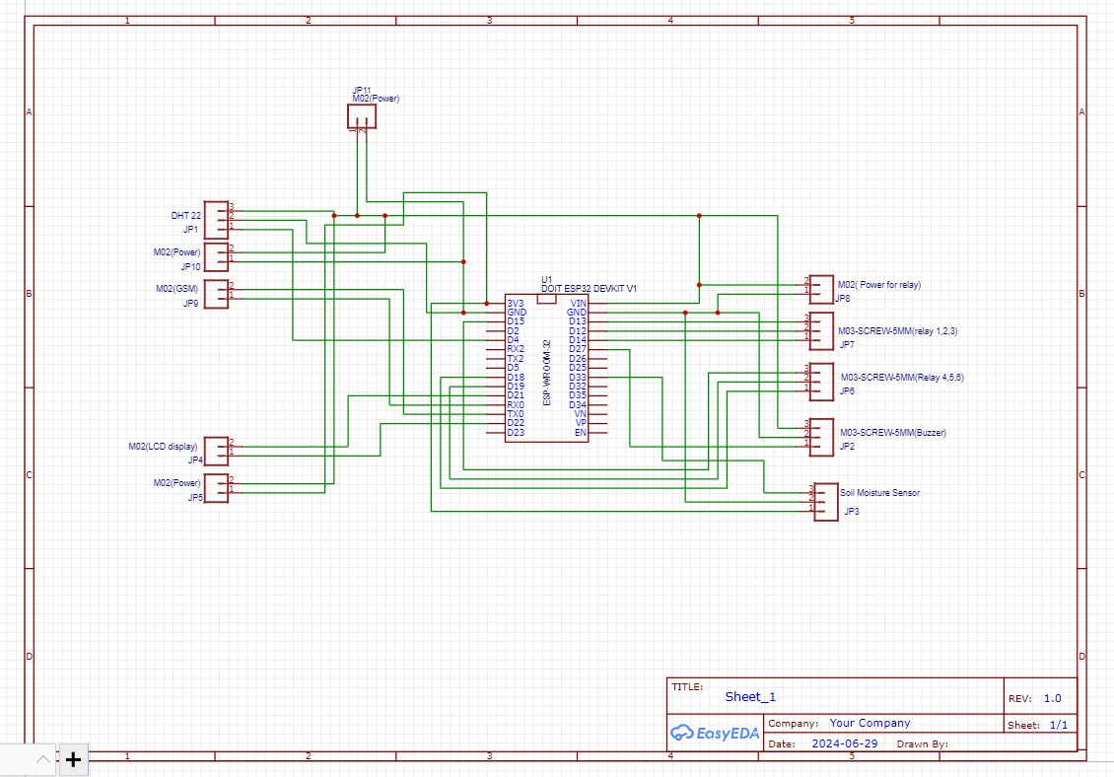
PCB DIAGRAM OF THE SYSTEM

Slide 10
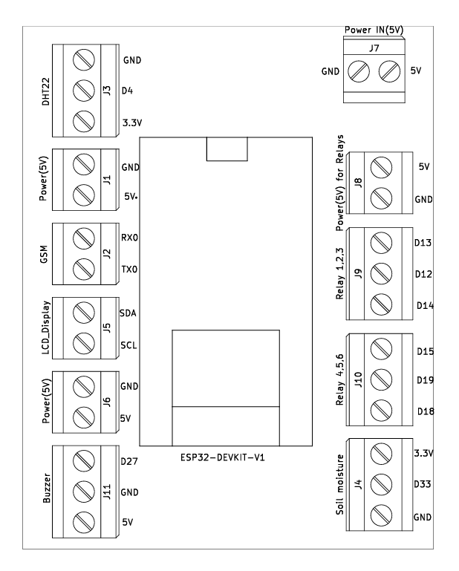
PCB DESIGN

Slide 11
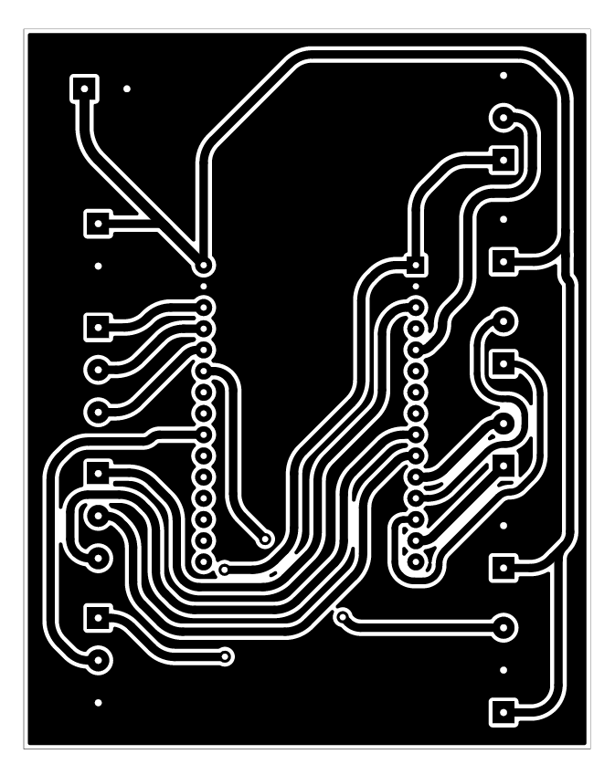
PCB LAYOUT

Slide 12
COMPONENTS
HARDWARE COMPONENTS
SOFTWARE COMPONENTS
ESP32
DHT22
Industrial Humidifier
SOIL MOISTURE SENSOR
TEC1-12706 PELTIER
THERMOELECTRIC COOLER
SIM900A GSM Module
Buzzer Module
Neon Light Strip
Cooling Fans
Pater Pump
EasyEDA
Arduino IDE
Figma
webench-POWER-DESIGNER

Slide 13
Individual
Contribution

Slide 14
224069V– HARISHANTH K.
RESPONSIBILITIES
Upon the data from ultrasonic sensor , send an alert SMS to the user letting him know that tank is empty when he is not close proximity to the device
Upon the data from ultrasonic sensor , send an alert by a buzzer sound letting him know that tank is empty when he is not close proximity to the device
COMPONENTS
GSM module
Active Buzzer module

Slide 15
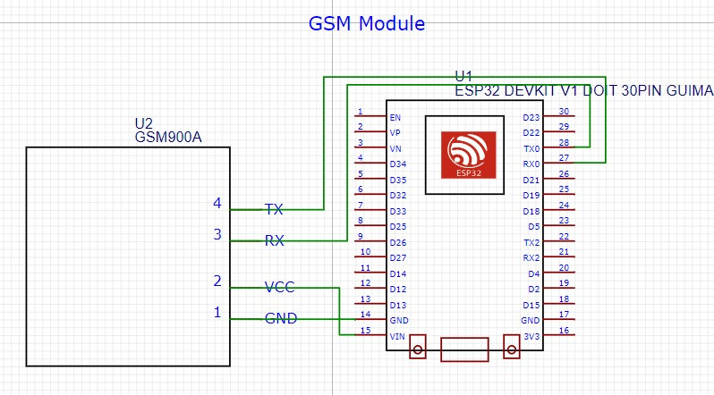
224069V– HARISHANTH K.
Circuit of the GSM module

Slide 16
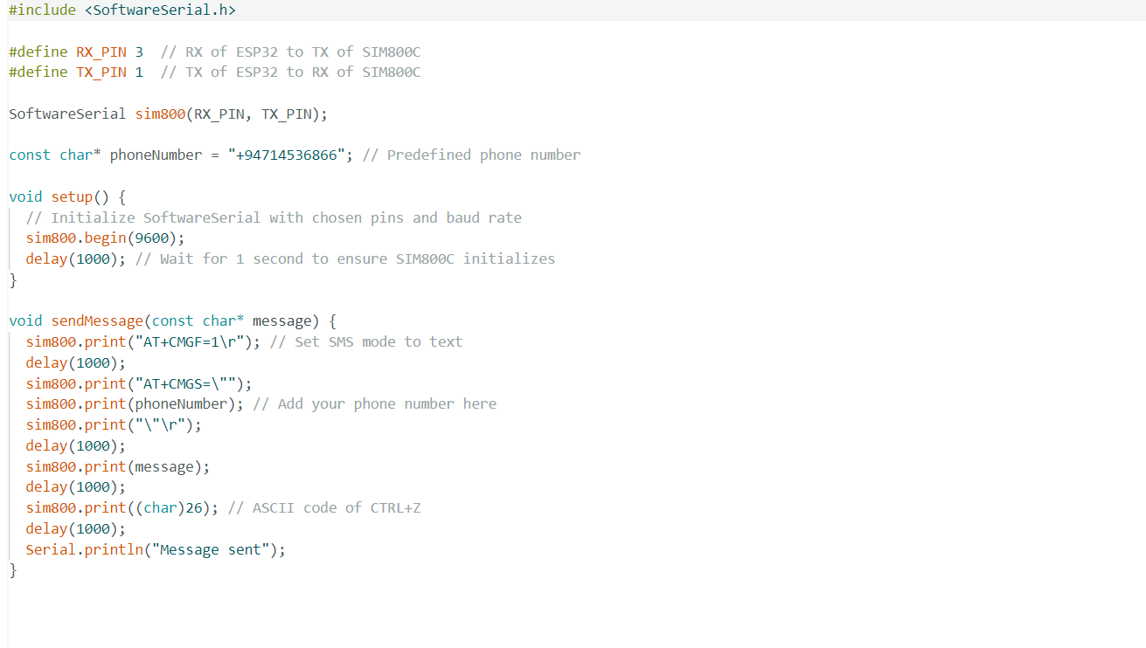
SOURCE CODE
GSM module

Slide 17
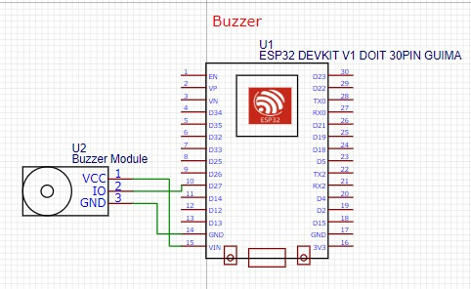
224069V– HARISHANTH K.
Circuit of the Active Buzzer module

Slide 18
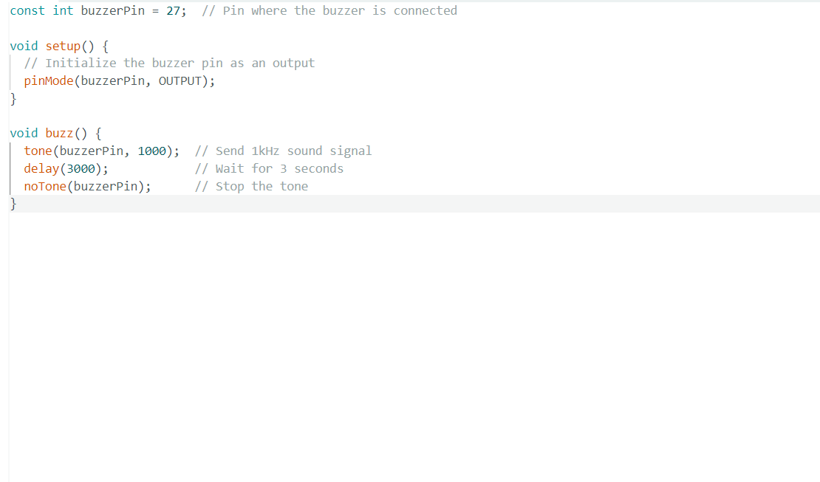
SOURCE CODE
Active Buzzer module

Slide 19
224038C– DHANUJA S.A.
RESPONSIBILITIES
Displaying the Temperature and humidity values that getting from DHT 22 in 16*2 LCD Display
Designing the Peltier unit AC module and Relay module
Use the Cooling fan with the relay module to reduce the temperature
Designing Schematic Diagram to create the PCB for the project
Designing the glass box according to the needs of the project
COMPONENTS
16x2 LCD Display
Peltier AC module with relay module
Cooling Fan with relay module
PCB Diagram

Slide 20
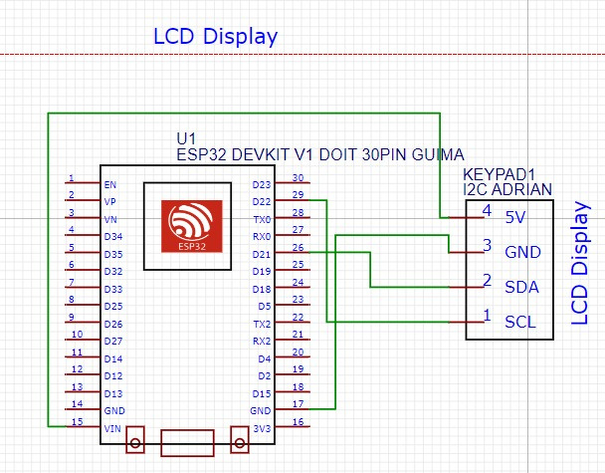
224038C– DHANUJA S.A.
Circuit of the 16x2 LCD Display

Slide 21
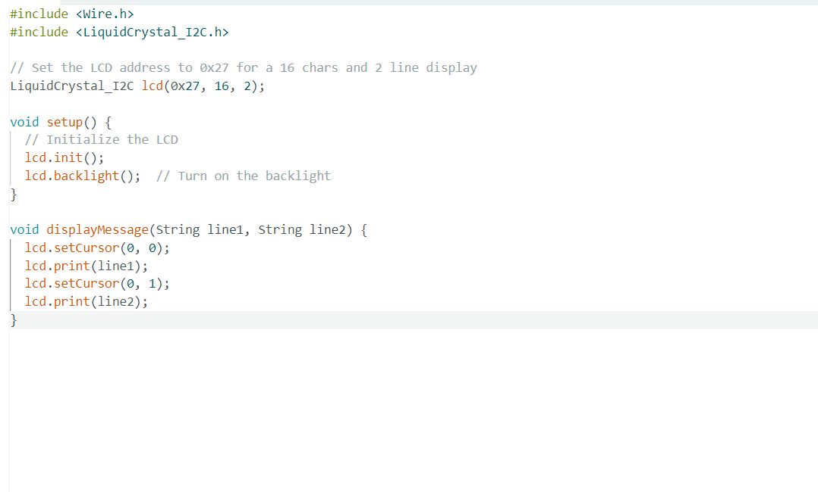
SOURCE CODE
Circu16x2 LCD Display

Slide 22
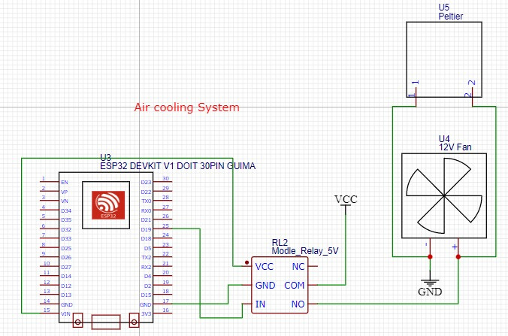
224038C– DHANUJA S.A.
Circuit of the Peltier AC module with relay module

Slide 23
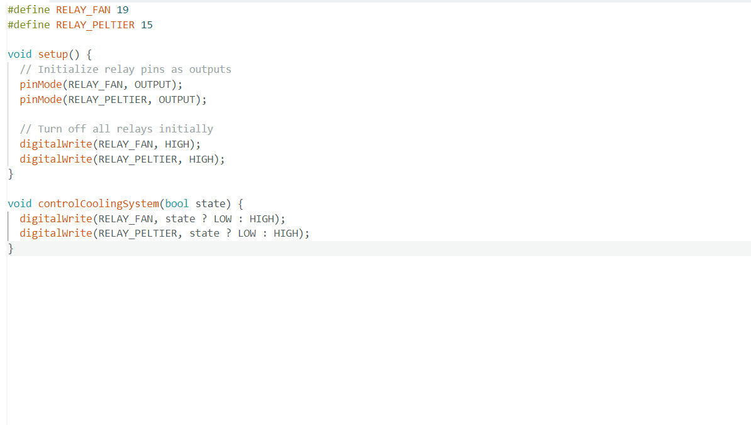
SOURCE CODE
Peltier AC module with relay module

Slide 24
224103X- KARUNARATHNA W.D.M.M.S.
RESPONSIBILITIES
Control the humidity within the glass box upon the data from DHT22 using Indusrial Humidifier and 12V water pump
Design the wood box of the physical Structure
Getting data about the temperature and humidity within the glass box using DHT 22 sensor
COMPONENTS
Industrial Humidifier
12V water pump
DHT 22 temperature and humidity sensor

Slide 25
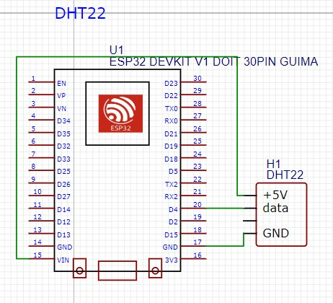
224103X- Karunarathna W.D.M.M.S.
Circuit of the DHT 22

Slide 26
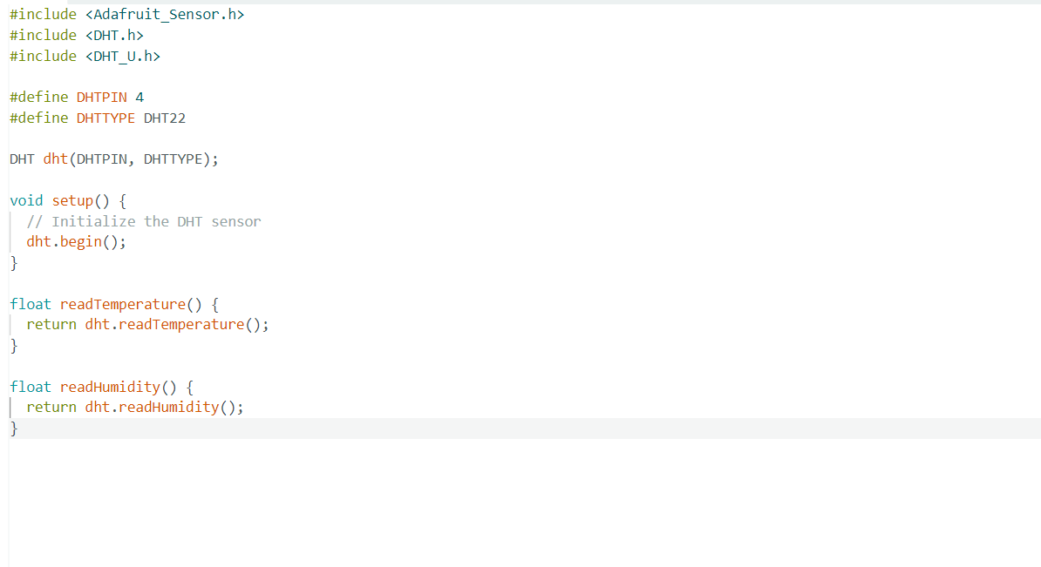
SOURCE CODE
DHT 22

Slide 27
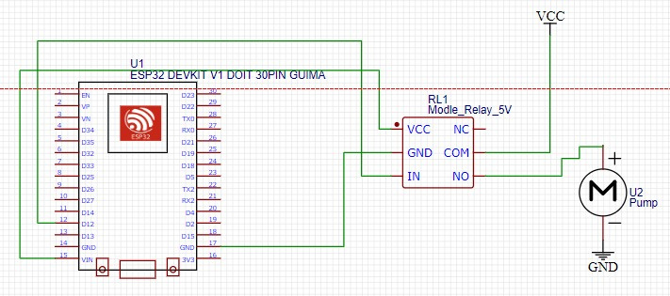
224103X- Karunarathna W.D.M.M.S.
Circuit of the 12V water pump

Slide 28
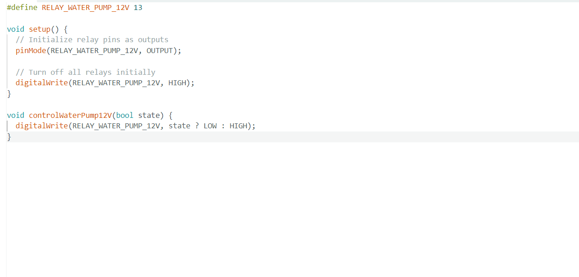
SOURCE CODE
12V water pump

Slide 29
224164H– RAVEENDRAN A.
RESPONSIBILITIES
Program the inbuilt RTC in the esp 32 to get the real time data of the area and to light the neon light strip for given period of time
Use Ultrasonic Sensor to detect the water level of the reserve tank and check whether it is empty or not
COMPONENTS
RTC in the esp 32
Ultrasonic Sensor

Slide 30
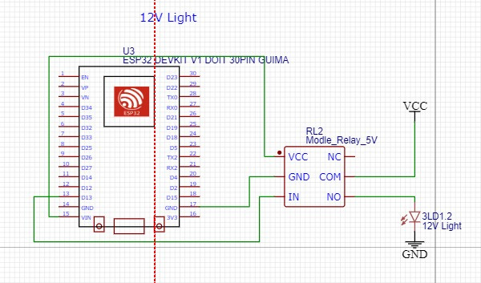
224164H– RAVEENDRAN A.
Circuit of the Neon light

Slide 31
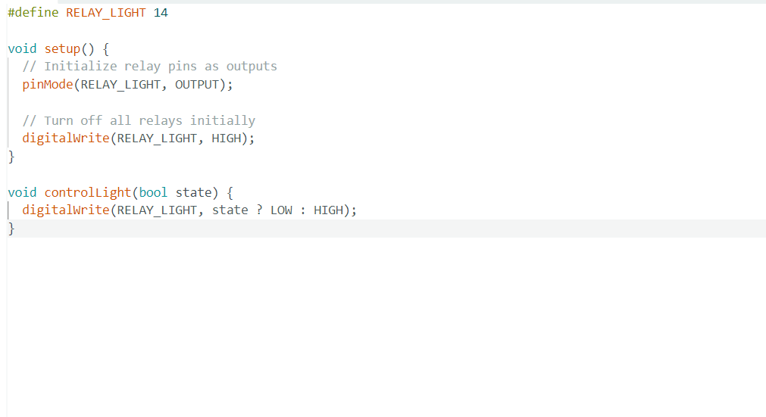
SOURCE CODE
Neon light

Slide 32
224199T– TISHANTH S.
RESPONSIBILITIES
Detect the soil moisture levels from the soil the plant planted in using Capasitive Soil Moisture sensor.
Use the 5V water pump to supply water to the plant when soil moisture levels go lower than a threshold value within a pre-selected amount of time.
COMPONENTS
5V water pmup
Capasitive Soil moisture senosr

Slide 33
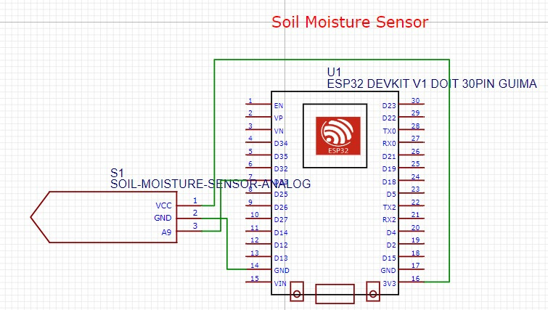
224199T– TISHANTH S.
Circuit of the Capasitive Soil moisture sensor

Slide 34
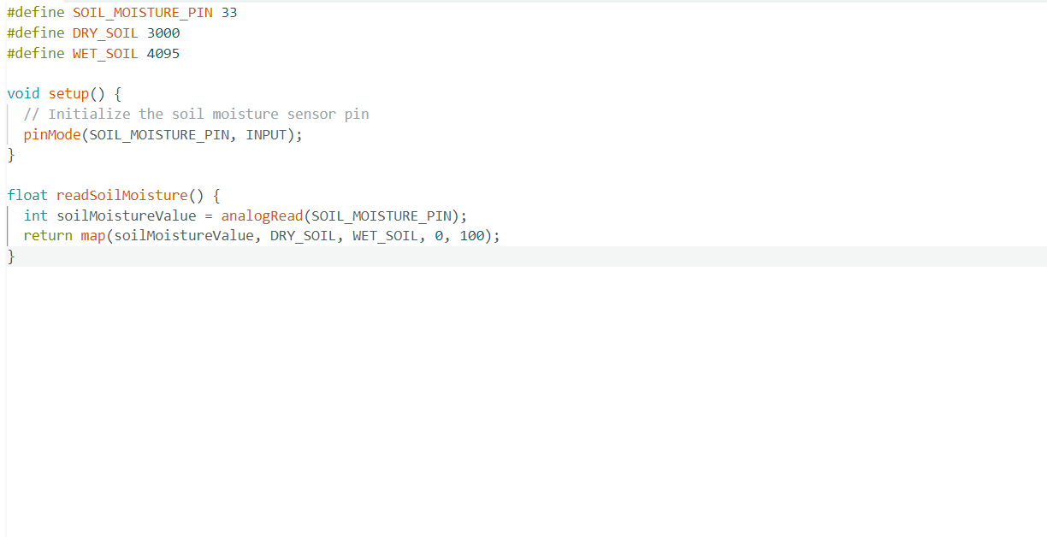
SOURCE CODE
Capacitive Soil moisture sensor

Slide 35
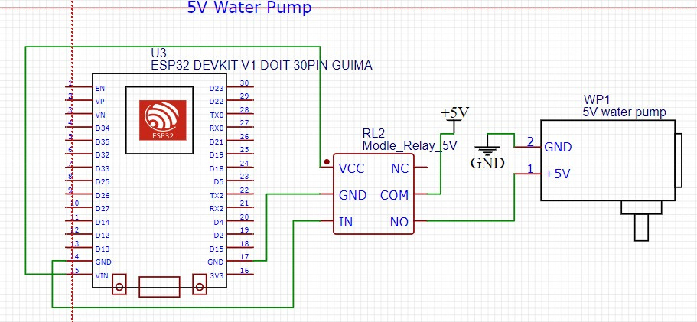
224199T– TISHANTH S.
Circuit of the 5V water pump

Slide 36
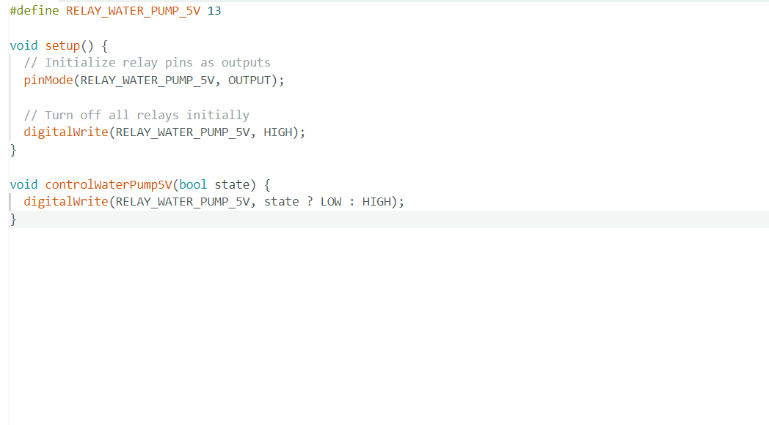
SOURCE CODE
Circuit of the 5V water pump

Slide 37
FULL SOURCE CODE
https://drive.google.com/drive/folders/1KQI8VzMfwivDjim0TRytLon4lXZX6IlA

Slide 38
Q & A

Slide 39
THANK YOU

